Slide 1

AWS CodePipeline
Baskar Kumarasamy
Date : 06/21/2021
@AWS Certified Developer – Associate @Certified Kubernetes Administrator(CKA)

Slide 2
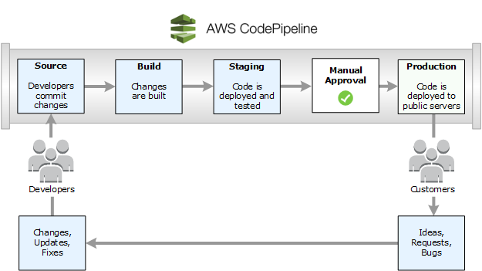
Quick a Look Codepipeline
@AWS Certified Developer – Associate @Certified Kubernetes Administrator(CKA)

Slide 3
AWS CodeCommit
Source Actions – AWS Code Commit:
Amazon ECR
AWS CodeStar Source Connection (Bitbucket)
AWS CodeStar Source Connection (GitHub)
AWS CodeStar Source Connection (GitHub Enterprise Server)
@AWS Certified Developer – Associate @Certified Kubernetes Administrator(CKA)

Slide 4
AWS CodeArtifact
Secure, scalable, and cost-effective artifact management
AWS CodeArtifact is a fully managed artifact repository service that makes it easy for organizations of any size to securely store, publish, and share software packages.
@AWS Certified Developer – Associate @Certified Kubernetes Administrator(CKA)

Slide 5
AWS CodeBuild
AWS CodeBuild is a fully managed continuous integration service that compiles source code, runs tests, and produces software packages that are ready to deploy. With AWS CodeBuild.
@AWS Certified Developer – Associate @Certified Kubernetes Administrator(CKA)

Slide 6
AWS CodeDeploy
-AWS CodeDeploy is a fully managed deployment service that automates software deployments to compute services such as Amazon EC2, AWS Lambda, and your on-premises servers.
-AWS CodeDeploy makes it easier for you to rapidly release new features, helps you avoid downtime during application deployment, and handles the complexity of updating your applications.
@AWS Certified Developer – Associate @Certified Kubernetes Administrator(CKA)

Slide 7
AWS CodePipeline
-AWS CodePipeline is a continuous integration and continuous delivery service for fast and reliable application and infrastructure updates.
-AWS CodePipeline builds, tests, and deploys your code every time there is a code change, based on the release process models you define
@AWS Certified Developer – Associate @Certified Kubernetes Administrator(CKA)

Slide 8
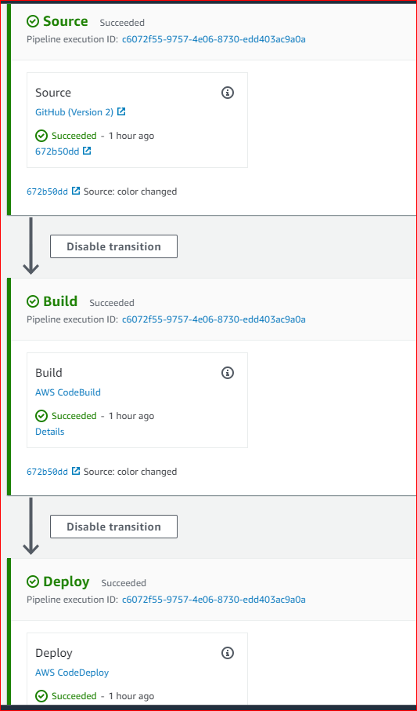
AWS CodePipeline
@AWS Certified Developer – Associate @Certified Kubernetes Administrator(CKA)

Slide 9

Questions
@AWS Certified Developer – Associate @Certified Kubernetes Administrator(CKA)

